Slide 1
Venice High School
International Baccalaureate
South County’s IB Magnet School

Slide 2
What is IB?
“IB” is short for “International Baccalaureate”
It is a two-year program that begins in a student’s junior year.
International program of studies for students who want to challenge themselves academically by taking a range of courses that follow a 1- and 2-year progression.

Slide 3

What are the Benefits of IB?
Wholistic approach to education and academics
A tight-knit community that grows together
Opportunities for Bright Futures and other Scholarships and Awards
IB Students are highly sought after by colleges and universities
Opportunity to achieve college credit
Academics focused on college preparedness

Slide 4
An Important District Fact
Venice High School is the South County IB Magnet School
IB is a district-approved magnet option

Slide 5
What Makes Venice IB Different
College-level thinking starting in high school
Strong writing, research, and communication skills
A small-community feel inside a comprehensive high school
Students known well by teachers and advisors

Slide 6
How Does the IB Program Help kids?
IB helps students…
Think deeply and independently
Ask strong questions and solve complex problems
Prepare for college-level expectations — not just tests
Grow academically and personally

Slide 7
IB at Venice High School
Two Pathways • One Purpose
IB Diploma Programme (DP)
A full academic diploma with broad, rigorous coursework
IB Career-Related Programme (CP)
Academic rigor paired with a focused career pathway

Slide 8
How does my child prepare for IB?
Maintain GOOD attendance
Take prerequisite courses!
Algebra 2 Honors face-to-face (Required for DP)
World Language—2 years face-to-face (Required for DP)
Career Pathway (Required for CP)
Time Management
Amount of homework per week varies by class, teacher and student. Be prepared to have homework weekly.
IB Assessments are largely reading and writing based.
Essay writing is required in every class. Strong writing skills are recommended and developed.

Slide 9
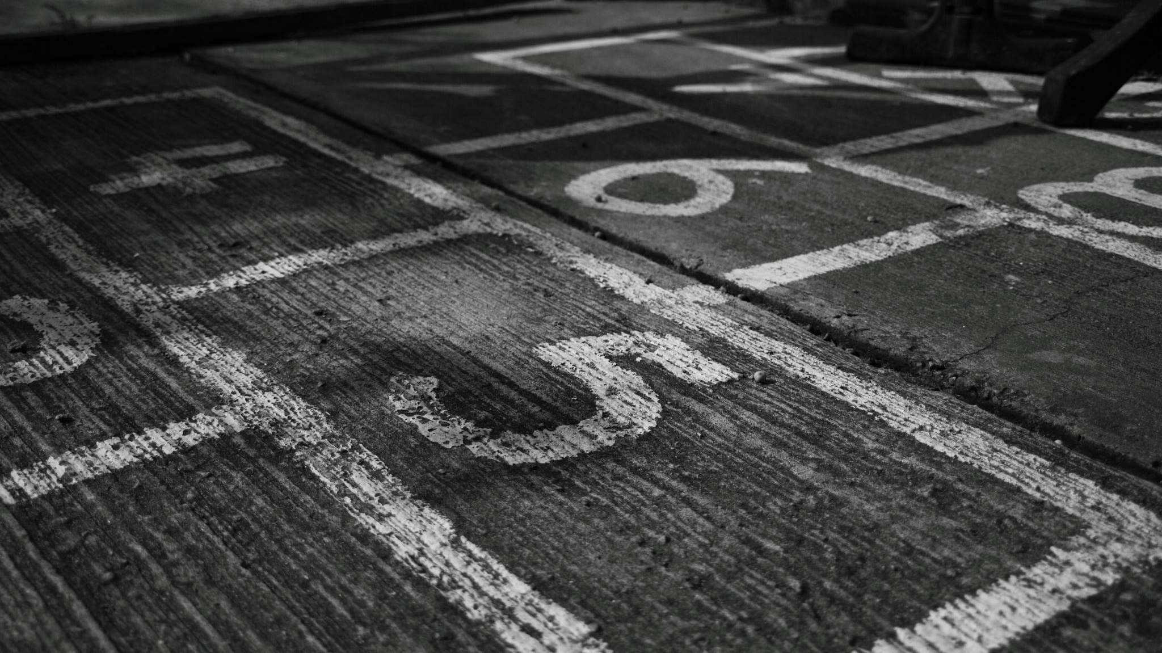
Other Prerequisites
3.0 GPA, unweighted
Passing Score of 3 on PM2 ELA FAST Assessment
Must be in good standing with Attendance and Discipline
Rising Juniors apply and are accepted into the IB Program if qualified
Rising Freshman and Sophomores must apply for the Pre-IB Track and register for Pre-Requisites with Guidance Counselors in the Spring!

Slide 10
IB Diploma Programme (DP)
Designed for students who:
Enjoy challenge across multiple subjects
Plan to attend a four-year college or university
Want a diploma recognized worldwide
Includes: Advanced coursework, research, writing, and exams

Slide 11

Diploma Program (DP)
Full IB Course Schedule
Waived from certain FL Graduation Requirements
IB Diploma Core
  Theory of Knowledge (TOK)
    Extended Essay
    Creativity, Activity, Service (CAS)

Slide 12
IB Career-Related Programme (CP)
Designed for students who:
Want rigor and real-world application
Thrive with focused career pathways
Plan to attend a four-year college or university, certification, or specialized training
Includes: Career pathways, IB coursework, and professional skills

Slide 13
Career Program (CP)
A Career-Related Study
Must take all FL Graduation Requirements
A minimum of three IB Courses (2-year Language and Literature is required)
IB Career Core
Personal and Professional Skills (PPS)
Language and Cultural Studies
Reflective Project
Community Engagement

Slide 14
Career Pathways
Medical/EKG
Engineering Technology
Business Entrepreneurship
Computer Science
Multimedia Design
JROTC
Music

Slide 15
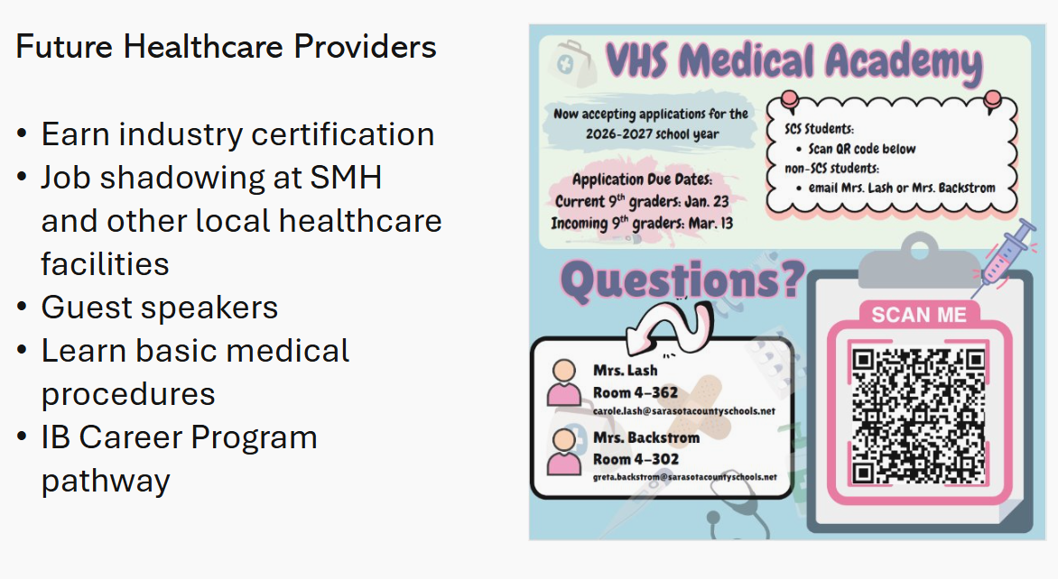

Slide 16
What 9th Grade Looks Like at Venice in Preparation for the IB Program (11th and 12th)
Honors-level core classes
World language progression (Diploma Program)
Early academic advising
IB support built in from the start

Slide 17
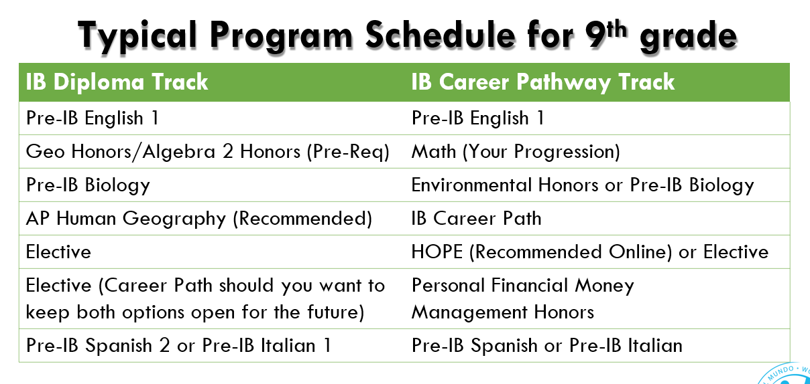
Possible schedule for 9th Grade

Slide 18
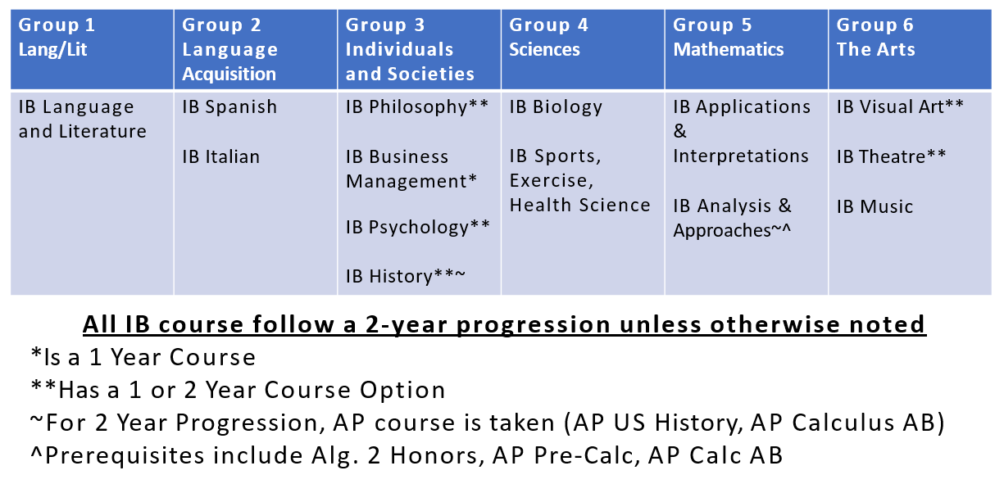
IB Courses Offered at Venice High

Slide 19
Support Is Part of the Design
Dedicated IB counselors and coordinators
Structured academic advising and check-ins
Teacher collaboration and communication
A culture that values balance and growth

Slide 20
Magnet Status: How It Works
Students districted to any school other than Venice High may apply
Venice IB is a district magnet program
Rising 11th students who are on campus have already applied
Rising 10th students who are on campus receive hard-copy applications this week
Rising 9th students (and all others) can apply digitally with a QR code that will be available at the end of this presentation and online at:
venicehighibprograms.com

Slide 21
Is Venice IB a Good Fit?
Venice IB may be a strong choice for students who:
Are curious and motivated
Want to be well prepared for college
Value strong relationships with teachers
Are ready to grow academically and personally

Slide 22
From Our Students
“IB taught me how to think, not just what to memorize.”
“I felt supported, even when the work was challenging.”
“IB prepared me for college in ways I didn’t expect.”

Slide 23
Beyond the Classroom
Athletics and fine arts
Clubs, leadership, and service
A full high school experience with IB structure and support

Slide 24
Meet the IB Team
Administration • Coordinators • Counselors
Mr. Brian Crocker, DP Coordinator
Ms. Gretchen Myers, CP Coordinator
Mrs. Brenda Bartlett, IB Counselor
Mrs. Brittany Rutherford, IB Assistant Principal of Curriculum
Questions? Email vhsibprograms@gmail.com
Website: venicehighibprograms.com

Slide 25

What’s Next?
Review the IB Program flyer at venicehighibprograms.com
Rising 10th on campus: apply in ELA this week
Rising 9th (and all others): apply this week using the QR code at the end of this presentation or on our site
VHS IB will email you directly with acceptance or denial
If you are accepted, you will need to also apply through the district magnet process on the district site

Slide 26
Expectations of Pre-IB Track Acceptance
If you are districted to another school and do not maintain standard requirements or have issues with attendance, academic integrity, or discipline, IB reserves the right to remove you from the Program or Track—this will result in removal of Magnet status and a return to your home-districted school
If you are districted to VHS and do not maintain standard requirements or have issues with attendance, academic integrity, or discipline, IB reserves the right to remove you from the Program or Track and reschedule you on a standard course of study

Slide 27
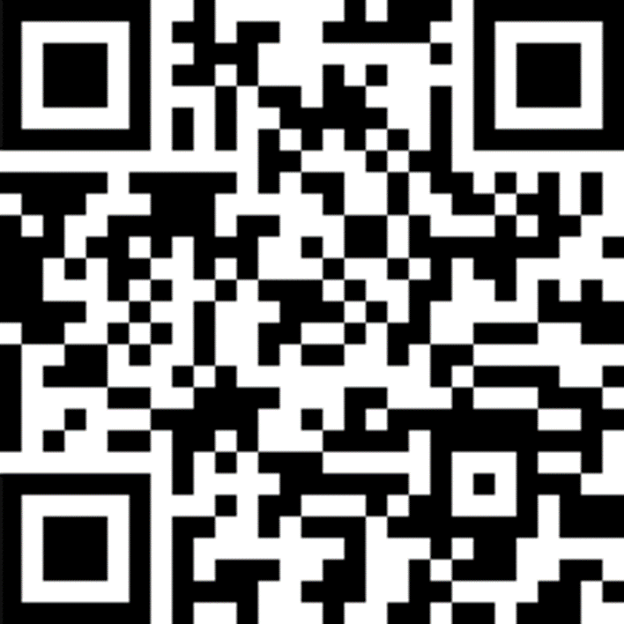
Thank You for Being Here
We look forward to partnering with your family. You are invited to join our IB Boosters…

Slide 28
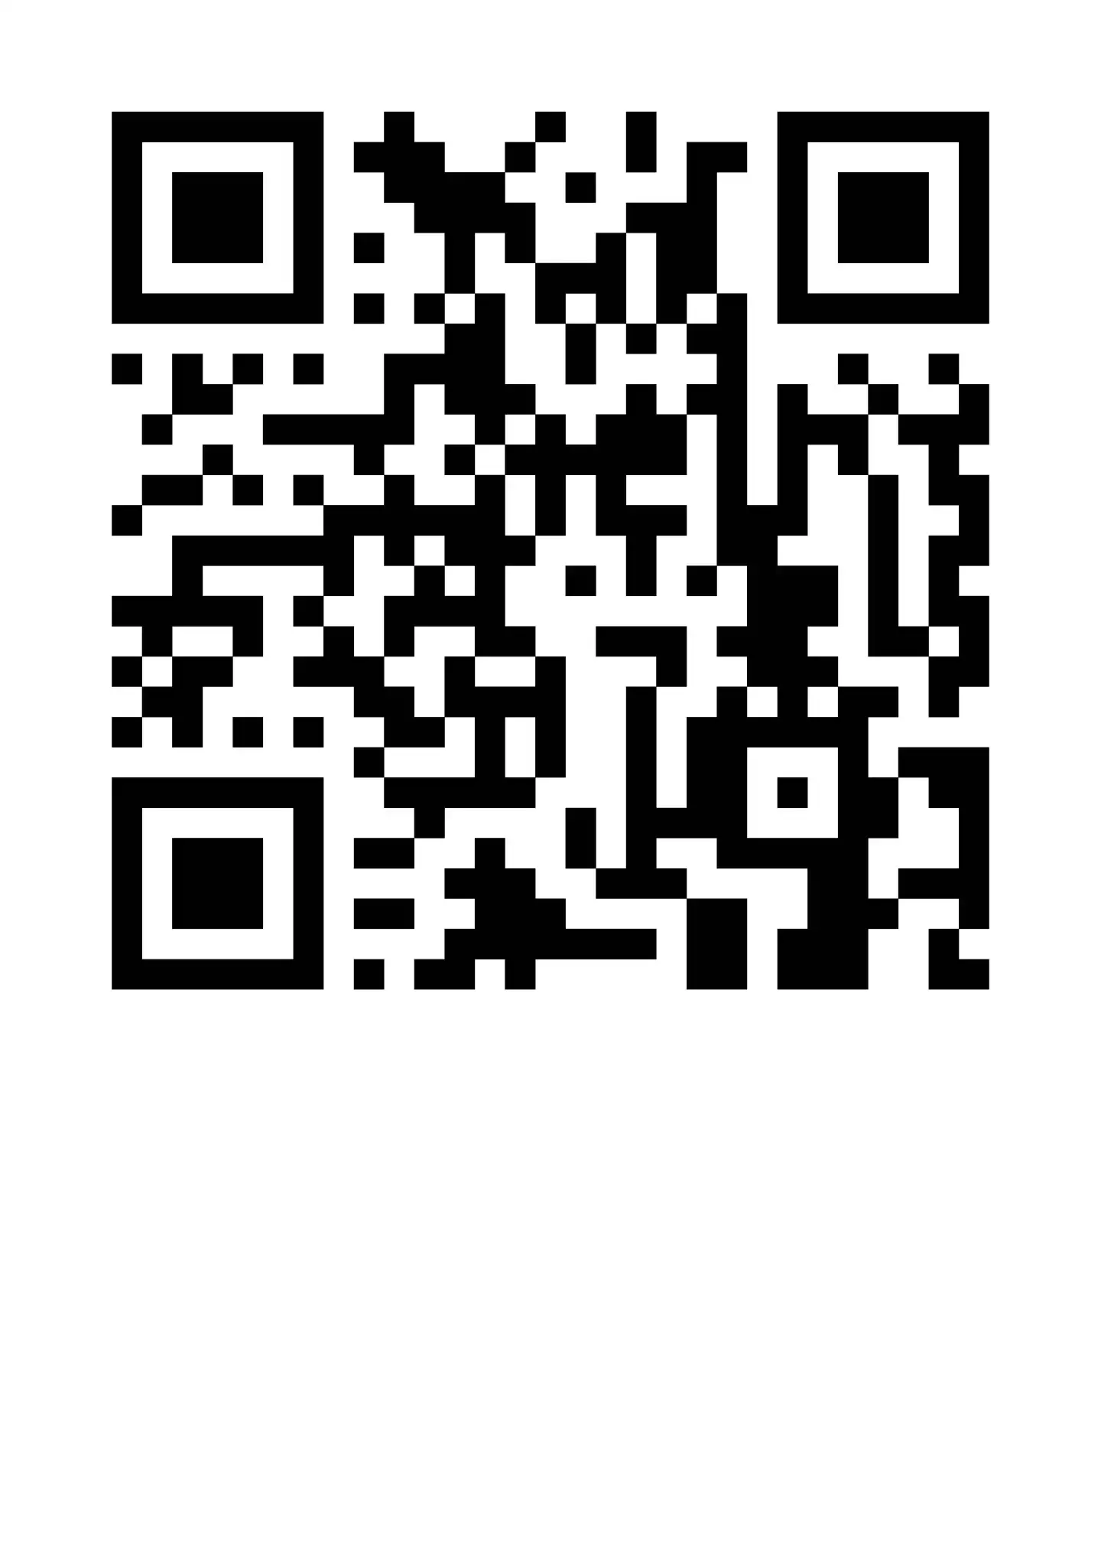
IB Application for ALL Students

